Slide 1

ARTIFICIAL INTELLIGENCE AND ROBOTICS 2024/2025
COMPUTER VISION PROJECT
SYNTHETIC DENTAL
X-RAY
GENERATION AND SEGMENTATION ANALYSIS
ROBERTO PASSANTE (1897160), GIORGIO DE SANTIS (1921727)

Slide 2

Synthetic data generation
Teeth Segmentation
MAIN
CHAPTERS
Evaluation
t
Ablation Study
Future works

Slide 3
DATASET
Public Kaggle dataset (about 600 dental panoramic X-rays)
Each sample:
• Human mask
• Machine mask
• PNG images + JSON polygons

Slide 4

SYNTHETIC DATA GENERATION
Why Synthetic Data?
Limited real data
Data scarcity in medical imaging
Goal: enlarge dataset with synthetic samples

Slide 5


Pix2Pix GAN
Generator: U-Net
Discriminator: PatchGAN (70×70)
GAN loss + L1 loss
Generator :
U-Net
Discriminator : PatchGAN (70×70)
GAN loss + L1 loss
ABLATION STUDY
Variant of Pix2Pix
Generator: ResNet9

Slide 6
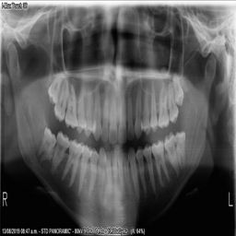
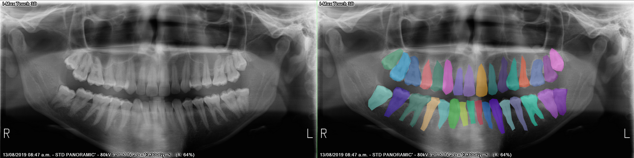
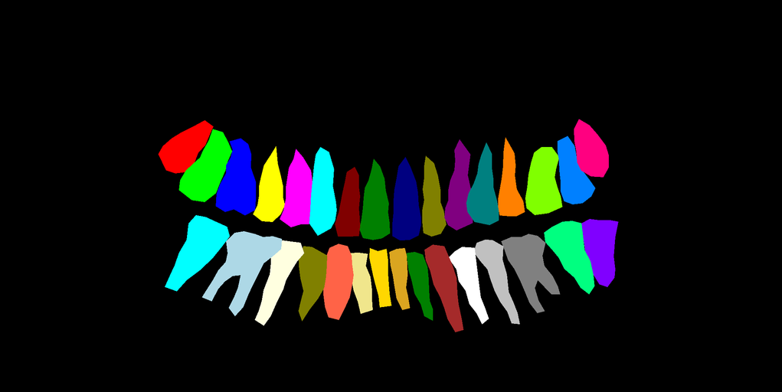
DATASET SAMPLE
Pix2Pix example input
Pix2Pix
example target

Slide 7

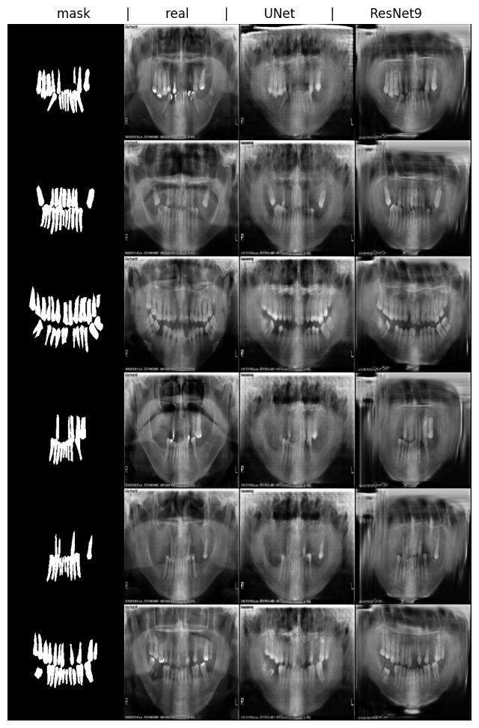
EVALUATION
Metrics
FID (global distribution)
KID (robust on small data)
LPIPS (perceptual similarity)

Slide 8

REDUCING DOMAIN GAP
Histogram Matching → global tone
CLAHE → local contrast
Denoising → reduce artifacts
Frequency filters → edges & illumination

Slide 9

TEETH SEGMENTATION
3 dataset version
REAL images
SYNTHETIC images
MIX (real + synthetic)
mix strategies
concatenation
replace
ratio

Slide 10

2 MODELS
MobileNetV2
(baseline)
TransUNet
(U-Net + Transformer)

Slide 11

2 METRICS
IoU
Dice
Intersection over Union
computation on 33 classes (32 teeth + background) and average
average of all dataset images
comparation between metrics computed with the 2 models

Slide 12
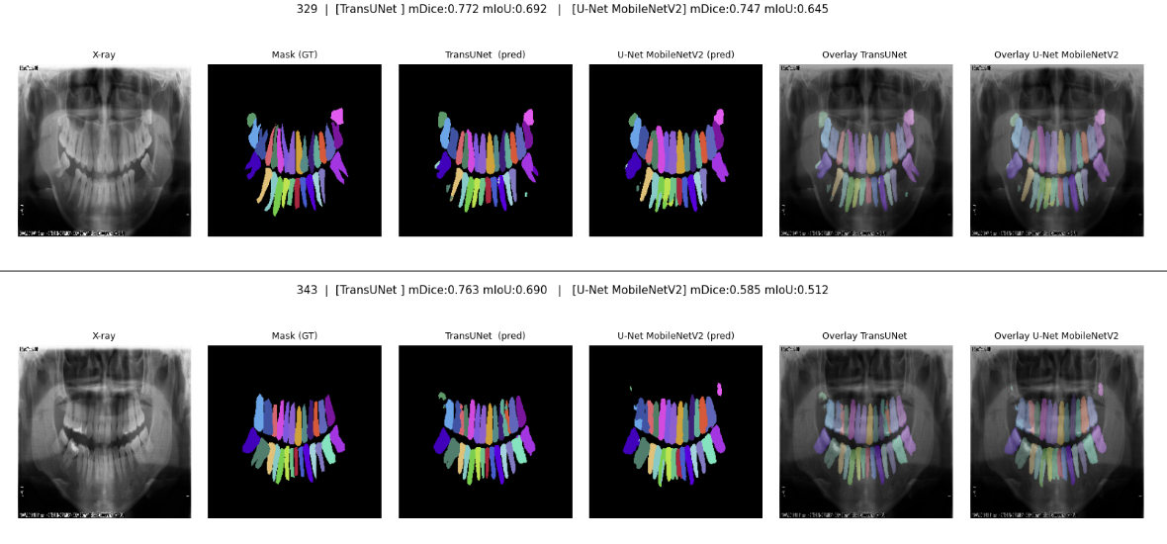

REAL IMAGES EVALUATION

Slide 13
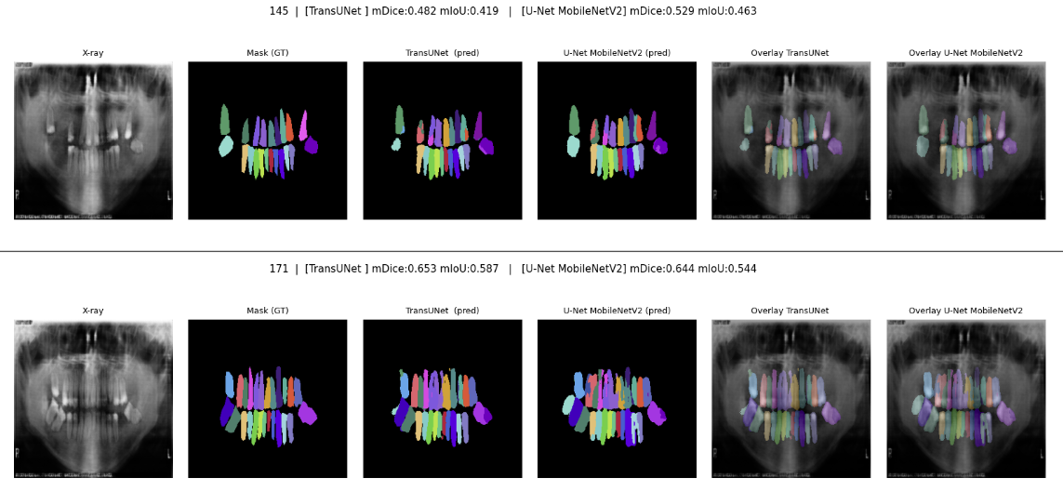

SYNTHETIC IMAGES EVALUATION

Slide 14
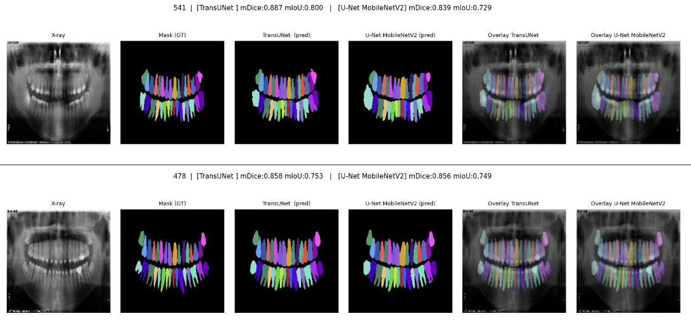
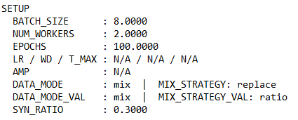

MIX IMAGES EVALUATION

Slide 15

FUTURE WORKS
heavier models for segmentation task
more advanced GAN architectures
stronger data augmentation strategies
different mix strategies combinations
[2]
CycleGAN
StyleGAN
Pix2PixHD
[3]
elastic deformations
random rotations and scaling
contrast/brightness adjustments

Slide 16
Thank you
for the attention
References:
[1] https://www.kaggle.com/datasets/humansintheloop/teeth-segmentation-on-dental-x-ray-images/data
[2] https://imarticus.org/blog/gan-architectures-for-image-generation
[3] https://pmc.ncbi.nlm.nih.gov/articles/PMC10027281

